Slide 1
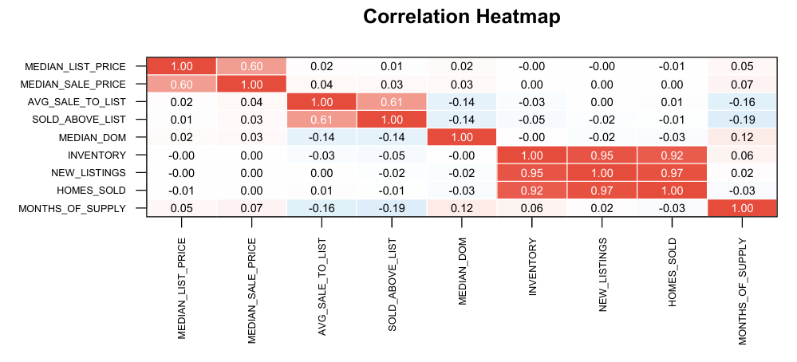
Dataset Overview - US Housing Market
831,771 rows, 58 variables
Data includes city-level housing metrics collected monthly
Covers prices, inventory, sales, competitiveness, and market timing
Key Findings
The median list price and median sale price exhibit a strong positive correlation (0.60), indicating that higher - priced cities tend to sell homes at higher prices as well.
Market competitiveness variables (average sale_to_list ratio and sold_above_list) are strongly correlated with each other (~0.61).
Supply - related variables (inventory, new listings, homes sold) are highly correlated among themselves (>0.90).
Done and presented by:
Pavithra Lakshmi Venugopal - FD0003363
Notes:
This dataset shows the market trends from 2012 to 2025. The dataset includes city-level metrics such as prices, inventory, new listings, sales activity, and market competitiveness.
This heatmap shows how the main housing metrics relate to each other across all U.S. cities in 2024 - 2025.
The strongest correlations appear in the housing activity variables - inventory, new listings, and homes sold - which all move together. This simply means that large, active markets tend to have more of everything.
List price and sale price also show a moderate relationship, which is expected because higher-priced cities usually have both higher asking and selling prices.
Finally, most other correlations are very weak, which shows the diversity across cities
Based on these strongest relationships, three hypotheses were formulated, each focusing on a different market mechanism:
H1 (Pricing behavior)
H2 (Market competitiveness
H3 (Supply - demand pressure)

Slide 2
Hypothesis 1
Cities with higher median list prices tend to have a larger gap between list price and sale price.
Key Variables Used for H1:
Median List Price
Median Sale Price
Price Gap = List Price - Sale Price
Price Gap % = Gap / List Price
City-level averages computed for analysis
Notes:
In other words, the assumption is that expensive markets show bigger differences between what sellers ask and what buyers actually pay.
To address Hypothesis 1, two fundamental variables are required: Median List Price and Median Sale Price. Observations missing either of these values cannot contribute meaningfully to the analysis; therefore, rows with missing values in these two variables were removed.
Rows were not imputed using averages because imputation would artificially distort price gaps, potentially creating relationships that do not exist in the real market.
Two new analytical variables were constructed:
PRICE_GAP, the difference between list and sale price, measures how much sellers adjust their expectations.
PRICE_GAP_PCT, the gap relative to the list price, accounts for differences between expensive and inexpensive cities.

Slide 3
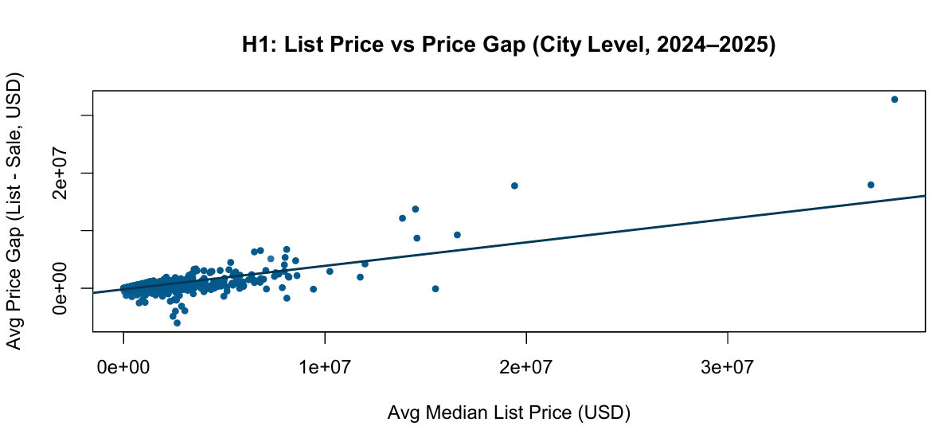
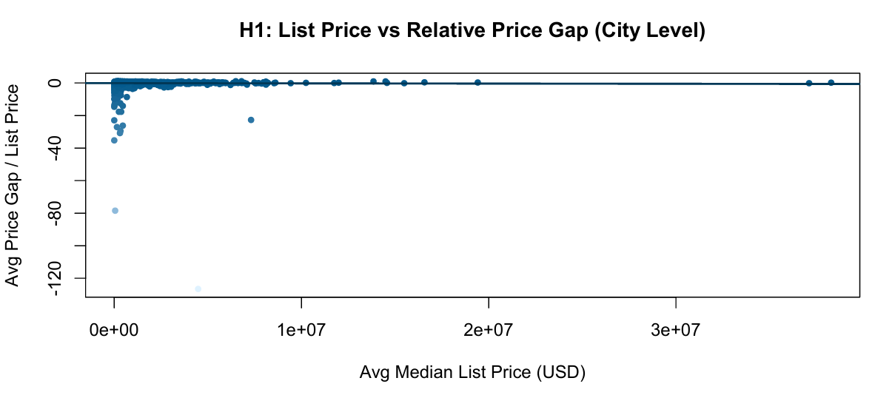
Correlation (List Price vs Price Gap USD): +0.72
A clear upward trend is visible: as the list price increases, the price gap also increases.
This means that high-priced cities tend to show much larger absolute differences between list and sale prices.
Correlation (List Price vs Price Gap %): - 0.008
Here, the points are nearly flat, with no visible trend.
It indicates that high-price markets are not disproportionately overpriced relative to their overall price level.
Notes:
The first scatter plot compares a city’s average list price to its average dollar-based price gap. A clear upward trend is visible: as the list price increases, the price gap also increases. This means that high-priced cities tend to show much larger absolute differences between list and sale prices. The correlation coefficient is +0.72, which is considered strong and positive, confirming this upward relationship.
The second graph uses the same variables but expresses the gap as a percentage of the list price. Here, the points are nearly flat, with no visible trend. The correlation is - 0.008, extremely close to zero. This indicates that although expensive cities have larger dollar gaps, these gaps are not unusually large once adjusted for the price level.
Dividing the price gap by the list price normalizes everything to a fraction.
A $40,000 gap on a $4M house becomes only 1%.
This artificially shrinks differences and hides real patterns.
So the percentage plot does NOT help answer our hypothesis,

Slide 4
Hypothesis 2
More competitive cities show higher sale_to_list ratios and lower days on market.
Key Variables Used for H2:
Sale_to_list ratio
% of homes sold above list price
Median days on market (DOM)
Notes:
The idea behind H2 is simple:
If buyers are competing more intensely, homes sell closer to (or above) list price and faster.
Outcome (Y): Median Days on Market (DOM)
Predictors (X):
Sale-to-list ratio
% of homes sold above list

Slide 5
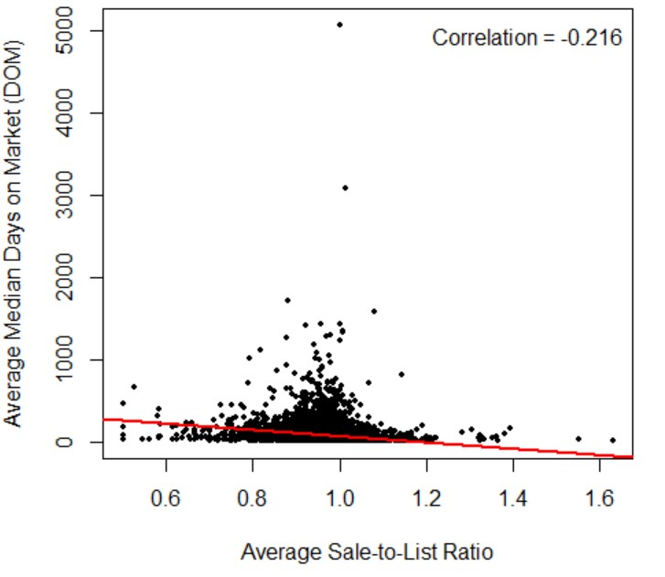
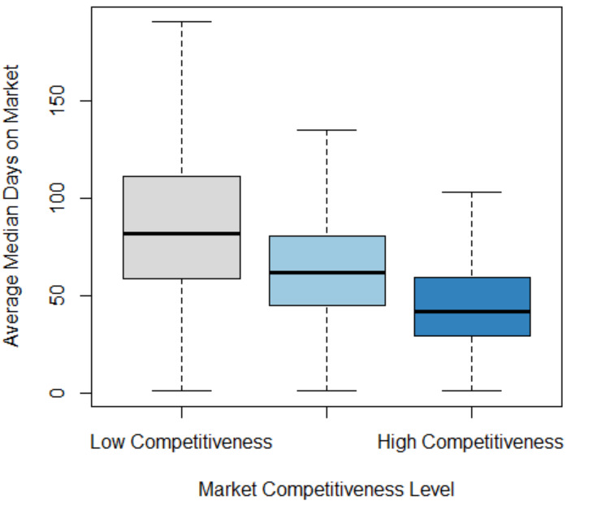
Analytical Method & Evidence for H2
Key Insights
Correlation: Sale_to_list vs DOM = -0.216
Correlation: % Sold Above List vs DOM = -0.212
Regression (DOM ~ Sale_to_list): β = -386.95, p < 0.001, R² = 0.0466
Low - competitiveness cities → highest median days on market and vice versa
Notes:
Scatter plot
The downward-sloping regression line indicates a negative relationship between sale-to-list ratio and days on market.
This means that as homes sell closer to or above their list price, they tend to sell faster.
The correlation value of −0.216 confirms a moderate but meaningful negative relationship, which is expected in large housing markets.
Box plot
Cities with:
High sale-to-list
High % sold above list
Low days on market → were classified as more competitive markets.
As competitiveness increases, the median days on market consistently decrease.
While R² is modest, the effect is statistically strong.
Conclusion: Hypothesis 2 is supported - competitiveness plays a meaningful role in market speed.

Slide 6
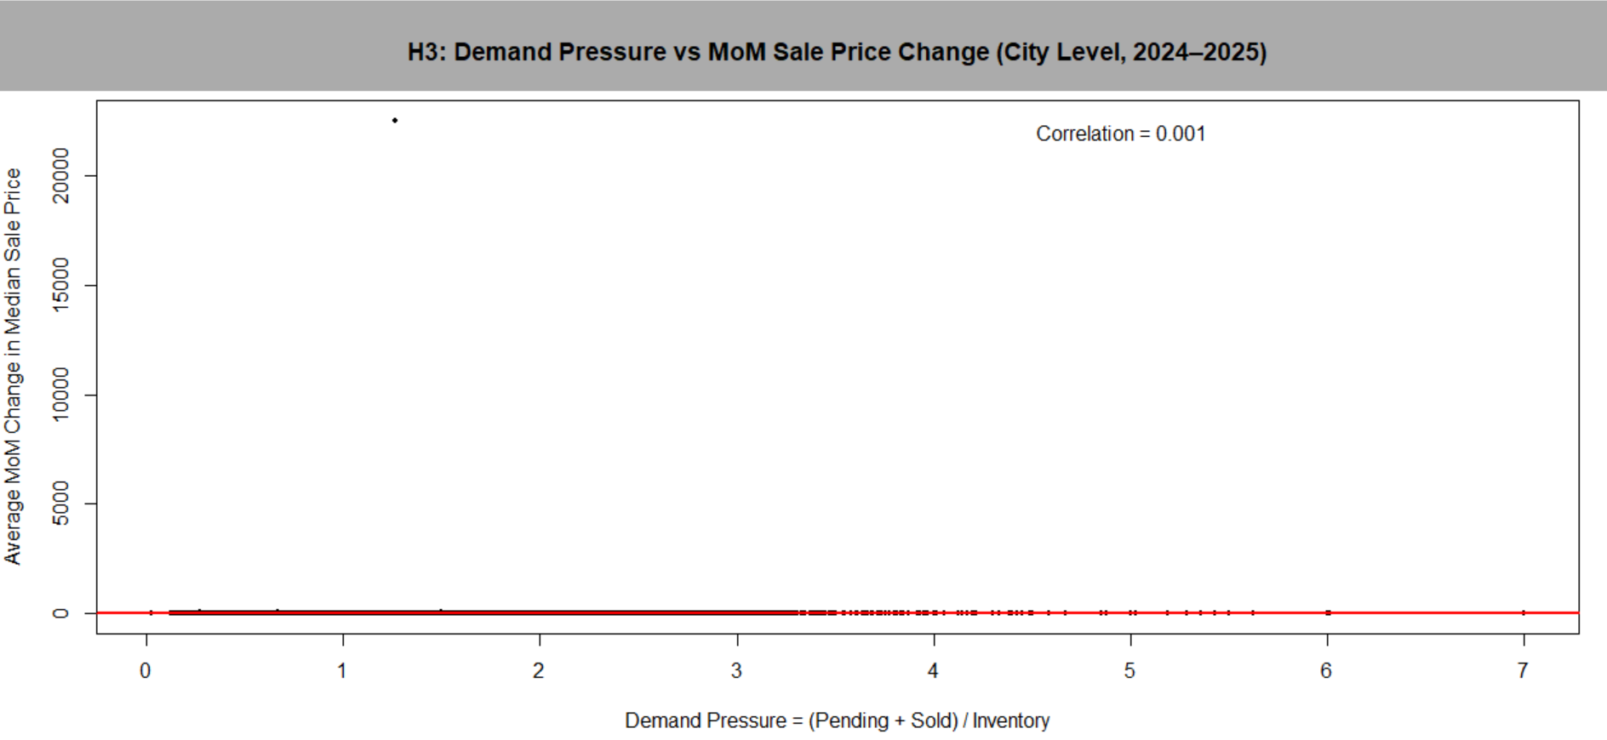
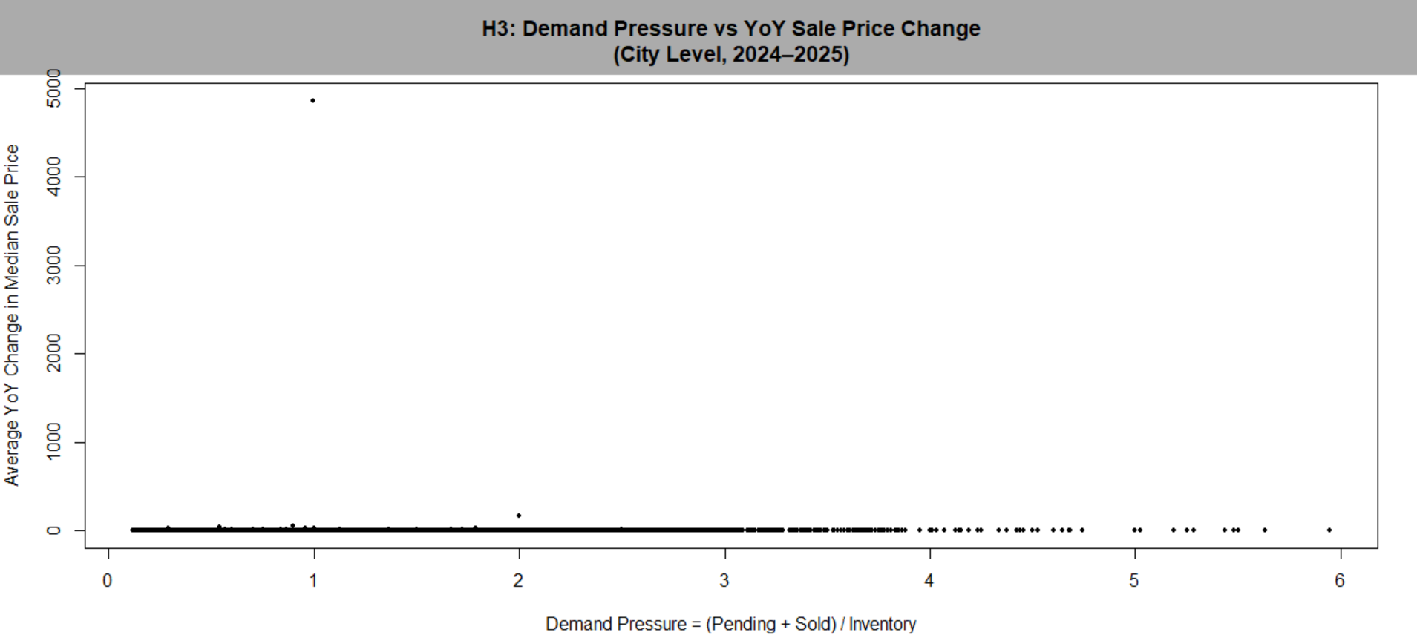
Hypothesis 3 Cities with stronger demand relative to supply experience higher short-term housing price growth.
Key Variables used for H3
Demand Pressure = (Pending Sales + Homes Sold) / Inventory
Price Change Metrics:
Month-over-Month (MoM)
Year-over-Year (YoY)
Notes:
This slide evaluates Hypothesis 3, which states that cities with stronger demand relative to supply experience higher short-term housing price growth.
To test this, a demand pressure index was constructed.
Demand pressure is defined as the sum of pending sales and homes sold, divided by available inventory.
Two price-change measures were analyzed to capture different time horizons:
Month-over-Month (MoM) change, reflecting short-term price movement
Year-over-Year (YoY) change, reflecting longer-term price growth
This scatter plot shows demand pressure plotted against average month-over-month sale price change at the city level.
The points are heavily concentrated around zero price change, and the regression line is nearly flat.
Although slightly smoother than the MoM results, the relationship remains very weak.
This indicates that price growth over one year is not directly explained by demand pressure alone.

Slide 7
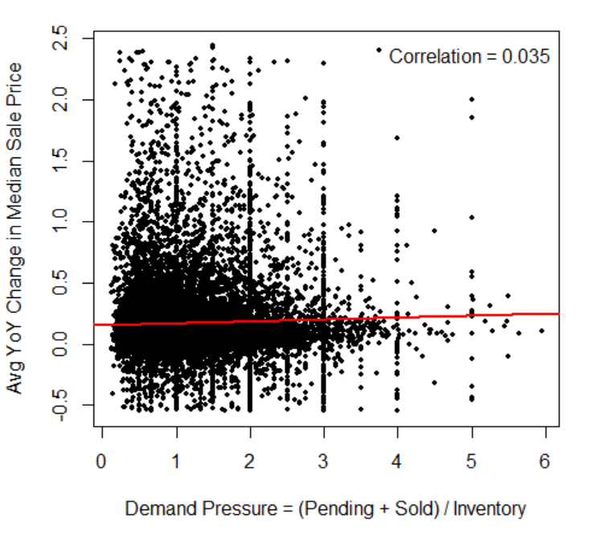
Interpretation & Conclusion (H3)
After Outlier Cleaning (City-Level, YoY)
Correlation: +0.035
Regression coefficient: +0.016
Key Insight: H3 is weakly supported: demand pressure contributes to price growth, but is not a primary driver.
Conclusion
H1 & H2 are supported by strong statistical evidence
H3 is weakly supported, indicating demand pressure alone does not strongly explain price changes
Notes:
After outlier cleaning at the city level, a weak positive relationship is observed between demand pressure and year-over-year price growth.
The correlation is +0.035, and the regression coefficient is +0.016, indicating that higher demand pressure is associated with slightly higher price growth. This relationship is statistically significant, but the effect size is very small.
Hypothesis 3 is weakly supported. Demand pressure influences prices, but other factors dominate housing price changes.

